Slide 1
UNIVERSAL LOGICAL GATES
DATA STRUCTURES

Slide 2
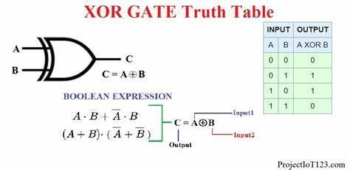
What is an XOR Gate?
An XOR gate (also known as an EOR, or EXOR gate) – pronounced as Exclusive OR gate – is a digital logic gate that gives a true (i.e. a HIGH or 1) output when the number of true inputs is odd. An XOR gate implements an exclusive OR, i.e., a true output result occurs if one – and only one – of the gate’s inputs is true. If both inputs are false (i.e. LOW or 0) or both inputs are true, the output is false.

Slide 3
What is an XOR Gate?
Truth table list the output of a particular digital logic circuit for all the possible combinations of its inputs. The truth table of an XOR gate is given below:
The above truth table’s binary operation is known as exclusive OR operation. It is represented as A ⊕ B. The symbol of exclusive OR operation is represented by a plus ring surrounded by a circle ⊕

Slide 4
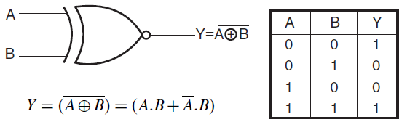
What is an XNOR Gate?
The XNOR gate (also known as a XORN’T, ENOR, EXNOR or NXOR) – and pronounced as Exclusive NOR – is a digital logic gate whose function is the logical complement of the exclusive OR gate (XOR gate). Logically, an XNOR gate is a NOT gate followed by an XOR gate.
The truth table of the XNOR gate is shown below:

Slide 5
What is an XNOR Gate?
The XOR operation of inputs A and B is A ⊕ B; therefore, XNOR operation those inputs will be (A + B) ̅. That means the output of the XOR gate is inverted in the XNOR gate.
In the XOR gate operation, the output is only 1 when only one input is 1. The output is logical 0 when both inputs are the same, meaning they are either 1 or 0. But in the XNOR gate, the inverse is true. Hence the output is 0 when only one input is 0, and the output is 1 when both inputs are the same (i.e. either two 0’s or two 1’s).
See the XNOR gate truth table below for a visual representation of this.

Slide 6


